Slide 1







C
D
S
E
N
S
E
E
- An AI Based Java Code Analyzser
Presented by :
N Sai Gayatri - 23AG1A67B1
G Sathish - 24AG5A6706
E Pranusha - 23AG1A6784
D Arjun Yadav - 23AG1A6772
Internal Guide:
Mrs. P. Saritha
(Assistant Professor)

Slide 2
1. ABSTRACT
2. INTRODUCTION
3. HARDWARE REQUIREMENTS
4. SOFTWARE REQUIREMENTS
5. ADVANTAGES
6. EXISTING AND PROPOSED SOLUTION

Slide 3


ABSTRACT
CodeSense is an AI-based web platform designed to help students understand and analyze Java programs effectively. Many learners can write Java code but struggle to explain logic, identify errors, and analyze time and space complexity. Existing tools mainly focus on code execution rather than conceptual understanding. CodeSense overcomes this limitation by performing static analysis on Java source code without executing it. The system explains program logic in simple English by analyzing loops, conditions, and control structures. It estimates time and space complexity using rule-based techniques. Based on this analysis, the platform suggests better algorithmic approaches to improve performance. CodeSense also integrates the original Java compiler for code validation. Basic debugging support is provided through error tracing and output analysis. Overall, CodeSense acts as an intelligent learning assistant for students

Slide 4
INTRODUCTION
Programming is a core skill for computer science students, and Java is one of the most widely used programming languages.
Many students can write Java programs but struggle to understand code written by others.
Learners often face difficulty in explaining program logic during exams and viva sessions.
Existing tools mainly focus on code compilation and execution rather than conceptual understanding.
Students also find it hard to analyze time and space complexity and identify inefficient approaches.
There is a growing need for an intelligent learning platform that helps students understand, analyze, and improve code.

Slide 5


SYSTEM
ARCHITECTURE
PROCESSOR
Intel Core i3 or higher
64-bit machine
HARDWARE
REQUIREMENTS
INPUT
DEVICES
RAM
Keyboard and Mouse
Minimum 4 GB
POWER
STABILITY
STORAGE
At least 10 GB free hard disk/SSD space
uninterrupted
power supply

Slide 6
HARDWARE
REQUIREMENTS
PROCESSOR
SYSTEM
ARCHITECTURE
Intel Core i3 or higher
64-bit machine
RAM
INPUT
DEVICES
Minimum 4 GB
Keyboard and Mouse
POWER
STABILITY
STORAGE
At least 10 GB free hard disk/SSD space
uninterrupted
power supply

Slide 7
SYSTEM
ARCHITECTURE
PROCESSOR
Intel Core i3 or higher
64-bit machine
SOFTWARE
REQUIREMENTS
INPUT
DEVICES
RAM
Minimum 4 GB
Keyboard and Mouse
POWER
STABILITY
STORAGE
At least 10 GB free hard disk/SSD space
uninterrupted
power supply

Slide 8
SOFTWARE
REQUIREMENTS
OPERATING
SYSTEM
FRONTEND TECHNOLOGIES
Windows / Linux / macOS
HTML, CSS, and JavaScript
JDK
IDE
JDK 8 or higher
IntelliJ IDEA / Eclipse / VS Code
WEB
BROWSER
BACKEND FRAMEWORK
Google Chrome or Mozilla Firefox
Spring Boot

Slide 9
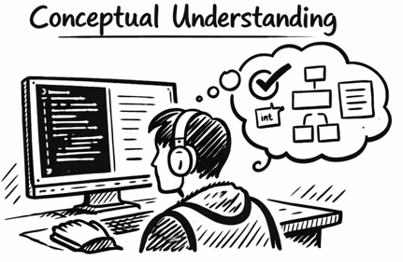

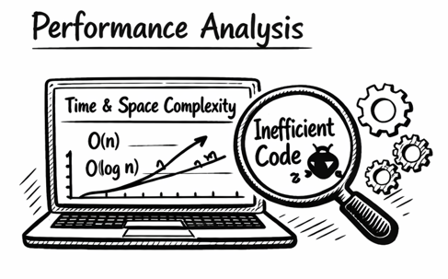
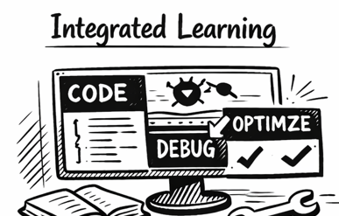
ADVANTAGES
The system explains Java program logic in simple English, helping students clearly understand how the code works instead of focusing only on output.
The project is designed for academic use, helping students explain logic, complexity, and improvements confidently during exams and viva sessions.
CodeSense analyzes time and space complexity and highlights inefficient code patterns, helping students learn optimization techniques.
The platform combines code explanation, compilation, debugging, and optimization suggestions in a single web-based interface.

